Slide 1
Molecular Dynamics Setup

Slide 2
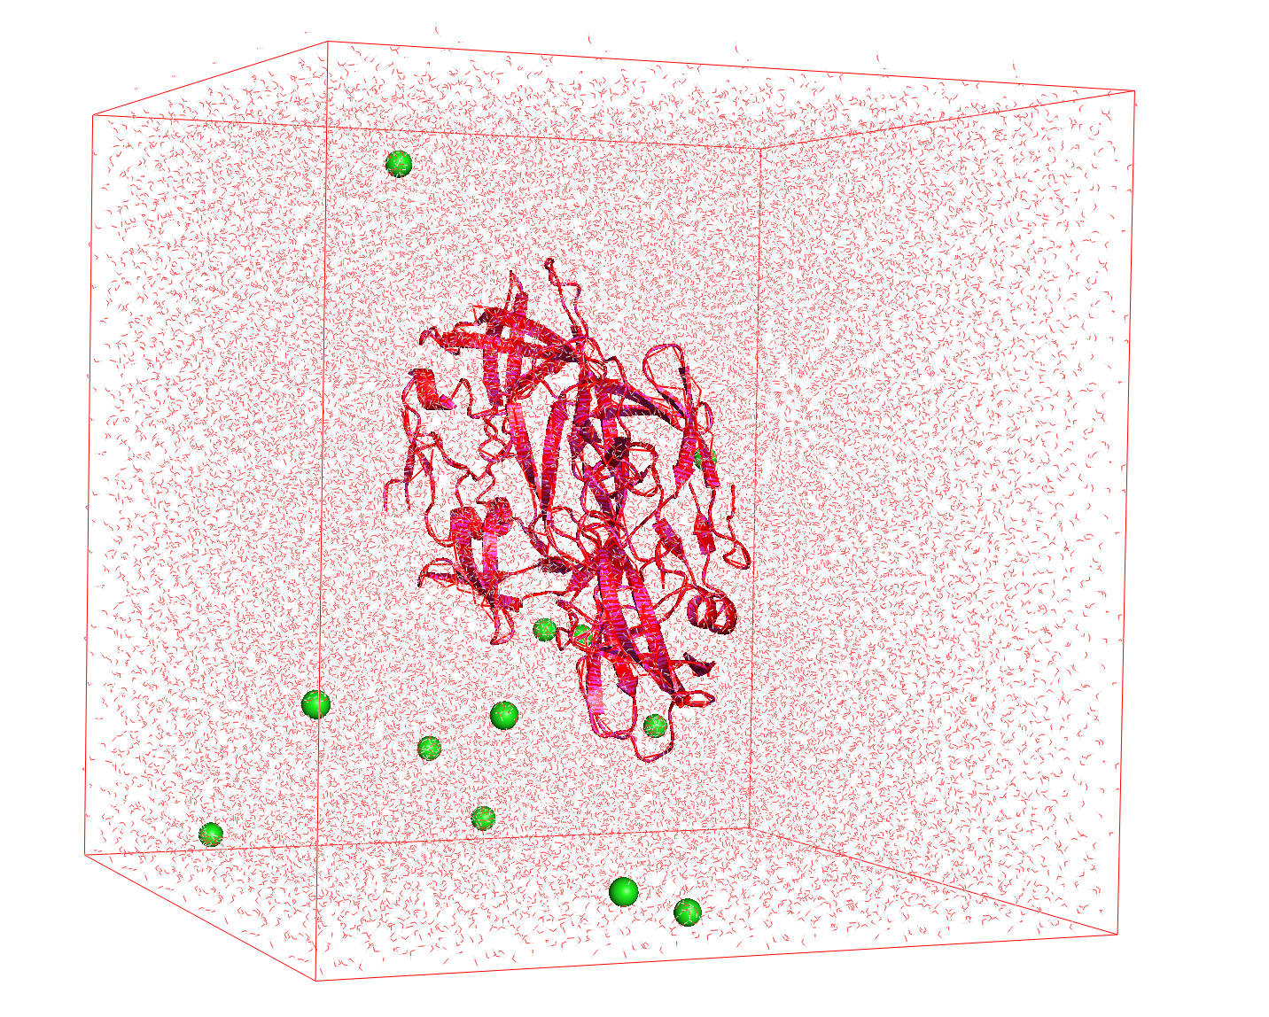
Molecular Dynamics: Introduction
Molecular dynamics (MD) is a computational technique used to simulate the dynamic behavior of biomolecules – which is motion of their atoms in time.
What MD essentially does:
Mimics what atoms do in real life, assuming a given potential energy function
Analyzing the physical movements of atoms and molecules
The energy function allows us to calculate the force experienced by any atom given the positions of the other atoms
Newton’s laws tell us how those forces will affect the motions of the atoms

Slide 3
Key properties in MD
In real life, and in an MD simulation, atoms are in constant motion
They will not go to an energy minimum and stay there.
Given enough time, the simulation samples the Boltzmann distribution *
That is, the probability of observing a particular arrangement of atoms is a function of the potential energy
In reality, one often does not simulate long enough to reach all energetically favorable arrangements
This is not the only way to explore the energy surface (i.e., sample the Boltzmann distribution), but it’s a pretty effective way to do so
* Boltzmann distribution - Probability distribution or probability measure that gives the probability that a system will be in a certain state as a function of that state's energy and the temperature of the system

Slide 4
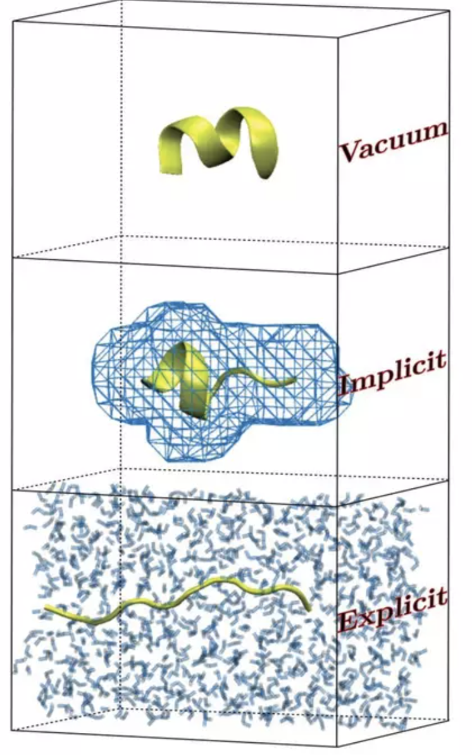
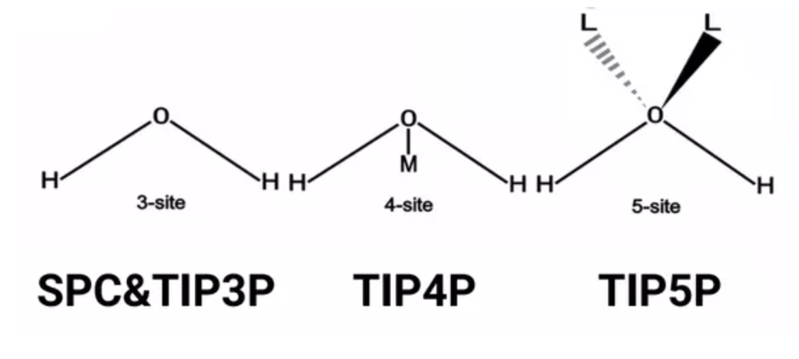
Solvation
Ignoring the solvent (the molecules surrounding the molecule of interest) leads to major artifacts.
Water, salt ions (e.g., sodium, chloride), lipids of the cell membrane
Provides dielectric effect that affects the electrostatic interactions for determining forces
Two options for taking solvent into account:
Implicit solvation - General Born (GN) models:
Mathematical model to approximate average effects of solvent
Solvent replaced with continuous, homogeneous, medium of bulk dielectric constants
Less accurate but faster (and easier to analyse)
Explicit solvation - SPC, SPC/E, TIP3P(our choice), TIP4P, TIP5P models
High computational expense but more accurate
Usually assume periodic boundary conditions
Actual model of solvent molecules

Slide 5
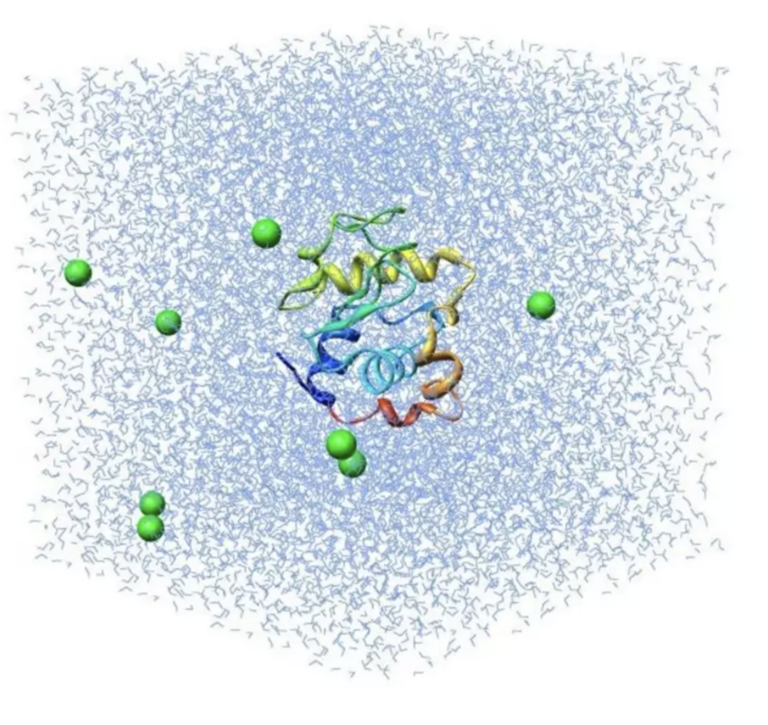
Ionization
Neutralizing a system is carried out for obtaining correct electrostatic values during the simulation.
Under periodic boundary and using PME (Particle Mesh Evald) electrostatics - the system has to be NEUTRAL.
Addition of ions means that some salt is present, however this is not equal to saline conditions.
If you want to simulate your system in the presence of a salt - neutralize and achieve the concentration of interest.
Some proteins in real might be sensitive to the salt concentrations, therefore ensure the positioning of ions is acceptable in the system prior to simulation
In implicit solvent the effect of a non-zero salt concentration could be modelled by specifying the Debye-Huckel screening parameter

Slide 6
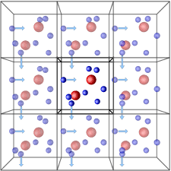
Periodic Boundary Conditions - Box
Boundary conditions are required to control the ﬂow of atoms/molecules moving away from simulation system
Central box represents the simulation system and surrounding boxes are replica (exact copy in all details, position, velocity, etc)
Whenever an atom leaves the simulation cell, it is replaced by the image which enters from the opposite cell (face of replica) entering and keeps the number of atoms is simulation cell conserved
Avoids the edge effect due to movement of system during simulation as well as molecule interacts with images in the replica to mimic the bulk phase.
Properties : pressure, stress, density, volume, area, etc

Slide 7
NonBonded methods (i.e. how to calculate the nonbonded interactions)
Method | Description | Periodic?
NoCutoff | No cutoff is applied to nonbonded interactions. The full set of N^2 interactions is computed exactly. This necessarily means that periodic boundary conditions cannot be used. This is the default. | ❌ No
CutoffNonPeriodic | Interactions beyond the cutoff distance are ignored. Coulomb interactions closer than the cutoff distance are modified using the reaction field method. | ❌ No
CutoffPeriodic | Periodic boundary conditions are used, so that each particle interacts only with the nearest periodic copy of each other particle. Interactions beyond the cutoff distance are ignored. Coulomb interactions closer than the cutoff distance are modified using the reaction field method. | ✅ Yes
Ewald | Periodic boundary conditions are used, and Ewald summation is used to compute the interaction of each particle with all periodic copies of every other particle. | ✅ Yes
PME | Periodic boundary conditions are used, and Particle-Mesh Ewald (PME) summation is used to compute the interaction of each particle with all periodic copies of every other particle. | ✅ Yes

Slide 8
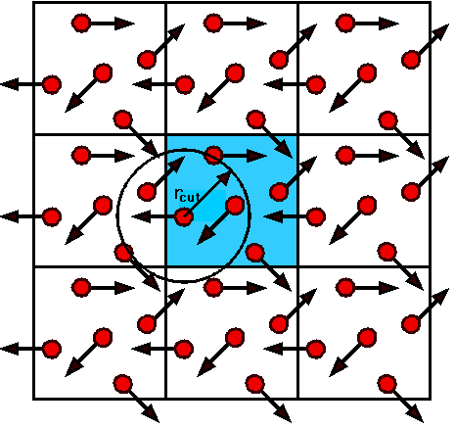
CutoffPeriodic
When using CutoffPeriodic in OpenMM:
You truncate Coulomb interactions at a finite distance (e.g., 1.0 nm).
But Coulomb forces decay slowly, so simply cutting them off can cause:
Discontinuities in forces and energy.
Incorrect dielectric environment.
Poor energy conservation.
This is where the Reaction Field (RF) comes in: it approximates the influence of the "bulk" beyond the cutoff by embedding the cutoff sphere inside a dielectric continuum.
In Reaction Field (RF), every Coulomb interaction within the cutoff radius Rc is modified from the standard potential. The idea is:
You still compute pairwise interactions only within the cutoff (no interaction at all beyond Rc).
But the form of the Coulomb potential within that cutoff sphere is altered to include the influence of the dielectric continuum beyond Rc

Slide 9
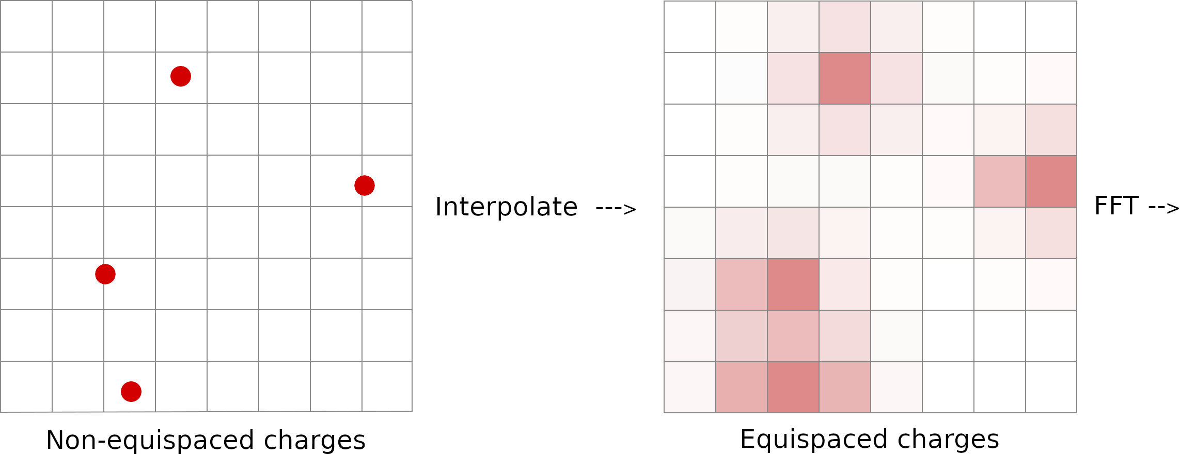
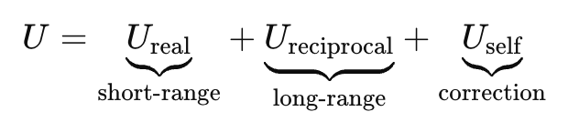
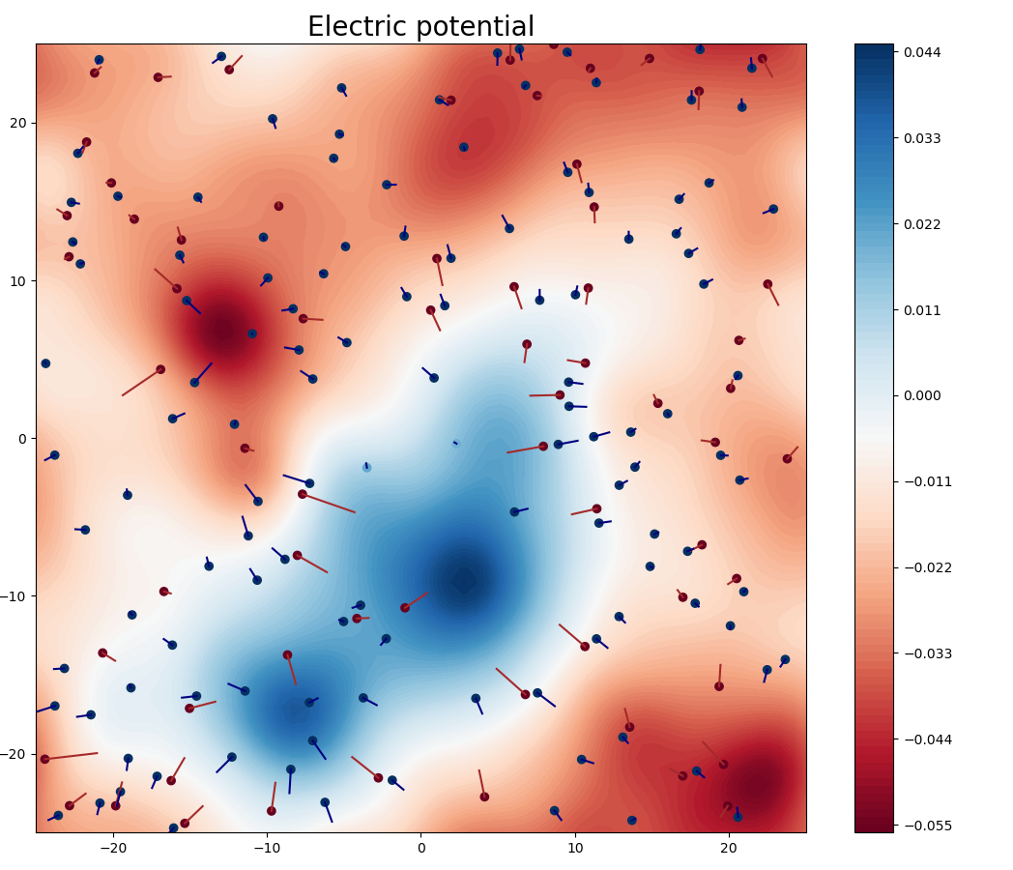
PME
Particle Mesh Ewald (PME) is a modern variant of the Ewald summation method, optimized for fast computation.
Ewald summation splits the electrostatic potential into two parts:
Short-range (real-space) term: computed directly in real space with a cutoff.
Long-range (reciprocal-space) term: computed in Fourier (reciprocal) space.
Self-interaction correction: subtracting the artificial interaction of each charge with itself.
Mathematically:
Steps:
1. Charge spreading (Interpolation)
Each particle’s charge is spread onto a 3D grid (using e.g., B-splines).
This forms a charge density field ρ(r) on a mesh.
2. Fourier Transform - Apply 3D FFT to compute the Fourier transform of the charge density ρ^ (k).
3. Multiply in reciprocal space
Multiply ρ^ (k) with the Green's function G^(k) that corresponds to the Coulomb potential in Fourier space.
This gives the electrostatic potential in Fourier space: ϕ^ (k)=G^(k)⋅ρ^ (k)
4. Inverse FFT - Inverse FFT gives the potential field ϕ(r) on the grid in real space.
5. Force interpolation
Interpolate the electric field (gradient of the potential) back from the grid to the particle positions.
Compute forces on each particle from this field

Slide 10
MD in energetic terms
Total energy (potential + kinetic) should be conserved:
In atomic arrangements with lower potential energy, atoms move faster
In practice, total energy tends to grow slowly with time due to numerical errors (rounding errors)
In many simulations, one adds a mechanism to keep the temperature roughly constant (a “thermostat”)
Thermostat will dampen the increase in energy over time. The surrounding atoms will absorb energy from the system if the system increases in energy

Slide 11
Mechanics of MD
Each atom (Ai) is considered as particle with mass (Mi) and charge (Qi)
From Newton’s Second law of motion* Fi= Mi*a, acceleration of the atom at time t can be calculated
Velocity (v) can be calculated from acceleration (acceleration is the derivative of velocity)
Position can be calculated from velocity (v) (velocity is the derivative of position)
Therefore, the position of atom at time (t), where Δt can be calculated
* Newton’s Second law of motion - second law states that the acceleration of an object is dependent upon two variables - the net force acting upon the object and the mass of the object.

Slide 12
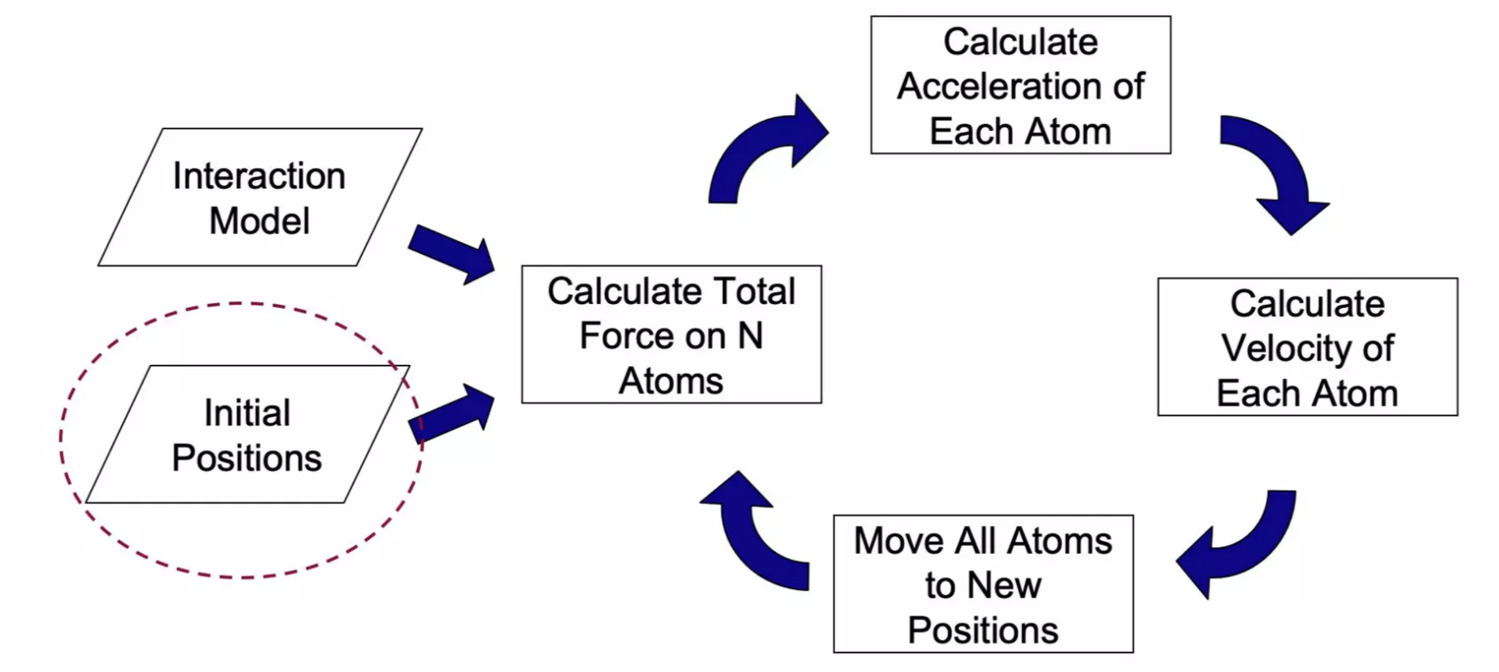
Initiation and Basics of MD process

Slide 13
Integrators in Molecular Dynamics (MD)
Purpose of Integrators: Numerically solve Newton's equations of motion to update particle positions and velocities over time:
LangevinMiddleIntegrator in OpenMM it’s a thermostatted integrator. It’s key properties:
Accurate position and velocity updates
Thermostat via Langevin dynamics (simulating ‘friction’ and Random thermal kicks)
Splits force & stochastic updates symmetrically (middle scheme)
LangevinMiddleIntegrator Benefits:
Better energy conservation
Improved stability at larger time steps

Slide 14
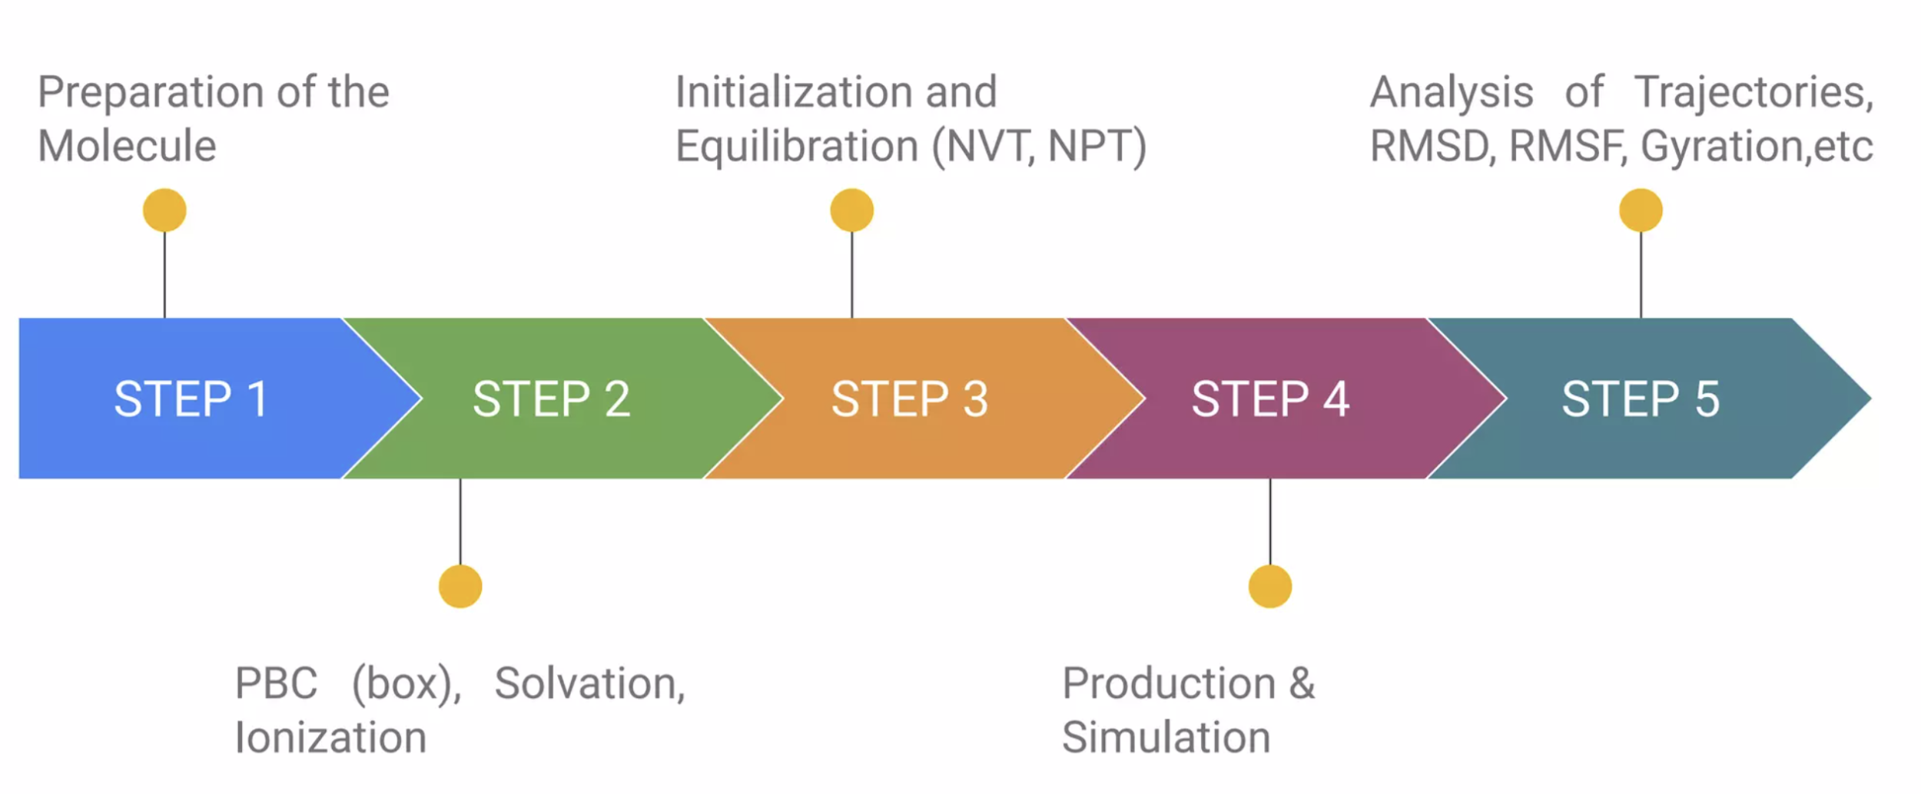
Steps in MD

Slide 15
Minimization | Equilibration
Minimization | Equilibration
Preparation of the system have introduced unnatural stress, for example by placing two atoms accidentally too close to each other. Result in large forces acting on the particles that would blow up the system To solve this problem, an energy minimization is performed in which the system is relaxed to the closest local energy minimum. | Equilibration phase is conducted under the ensemble(s) of interest to remove the effects of adding water, ions, and whatever else around some initial solute of interest. Or, more generally, remove the possible artifacts of whatever construction is done in whatever system of interest, which may be ordered (low entropy and high regularity) or totally random and therefore of unknown reality. Do not want the protein to move signiﬁcantly during the equilibration phase, we will restrain it with harmonic forces to its initial position.

Slide 16
Equilibration Ensembles
Microcanonical (NVE) | Canonical (NVT) | Isothermal–isobaric (NPT)
changes in moles (N), volume (V), and energy (E) Given the initial positions and velocities, we can calculate all future (or past) positions and velocities. | amount of substance (N), volume (V) and temperature (T) are conserved energy of endothermic and exothermic processes is exchanged with a thermostat | amount of substance (N), pressure (P) and temperature (T) are conserved Close to lab conditions with ambient temperature and pressure
Production simulations should be started when the system is already equilibrated. Production simulations normally are conducted under NPT ensemble. To start the Production run, we need to adjust our system’s temperature and pressure to the chosen fixed values – for most cases these are 300 K and 1 atmosphere.
To achieve this, we first need to run a short equilibrium simulation using a thermostat to heat our system to the target temperature and equilibrate it under this temperature. It is often done under NVT ensemple.
After temperature was equilibrated, we need to achieve a target pressure value – for this we run another short simulation using the thermostat (to keep the already equilibrated temperature) and the barostat (to equilibrate pressure) under NPT ensemble. These two steps also can be united into 1 step under NPT ensemble (that is – we’ll equilibrate both temperature and pressure at the same time)

Slide 17
Production MD simulation
After the system was equilibrated – we remove the restrains from the solute (e.g. protein) – essentially allowing it to move, and starting the long MD simulation under NPT ensemble
The goal of typical MD simulation is to have the equilibrium sampling during production – to collect the data about equilibrium ensemble of solute conformations (we’re trying to sample the Boltzmann distribution)
Typical parameters selected for MD simulation (Explicit solvent):
Step size(∆t) – fs scale (typically 2 fs)
Number of steps – to set the length of simulation (length = n_steps * step_size; for example 50000 steps of 2fs result in the 100ps simulation)
Temperature, Pressure – 300K, 1 atm
Constrains – H-bonds
Electrostatics – PME
Water model: TIP3P
Typical parameters selected for MD simulation (Implicit solvent):
Step size(∆t) – fs scale (typically 2 fs)
Number of steps – to set the length of simulation (length = n_steps * step_size; for example 50000 steps of 2fs result in the 100ps simulation)
Temperature, Pressure – 300K, not needed
Constrains – H-bonds
Electrostatics – PME
Water model: gbn2

Slide 18
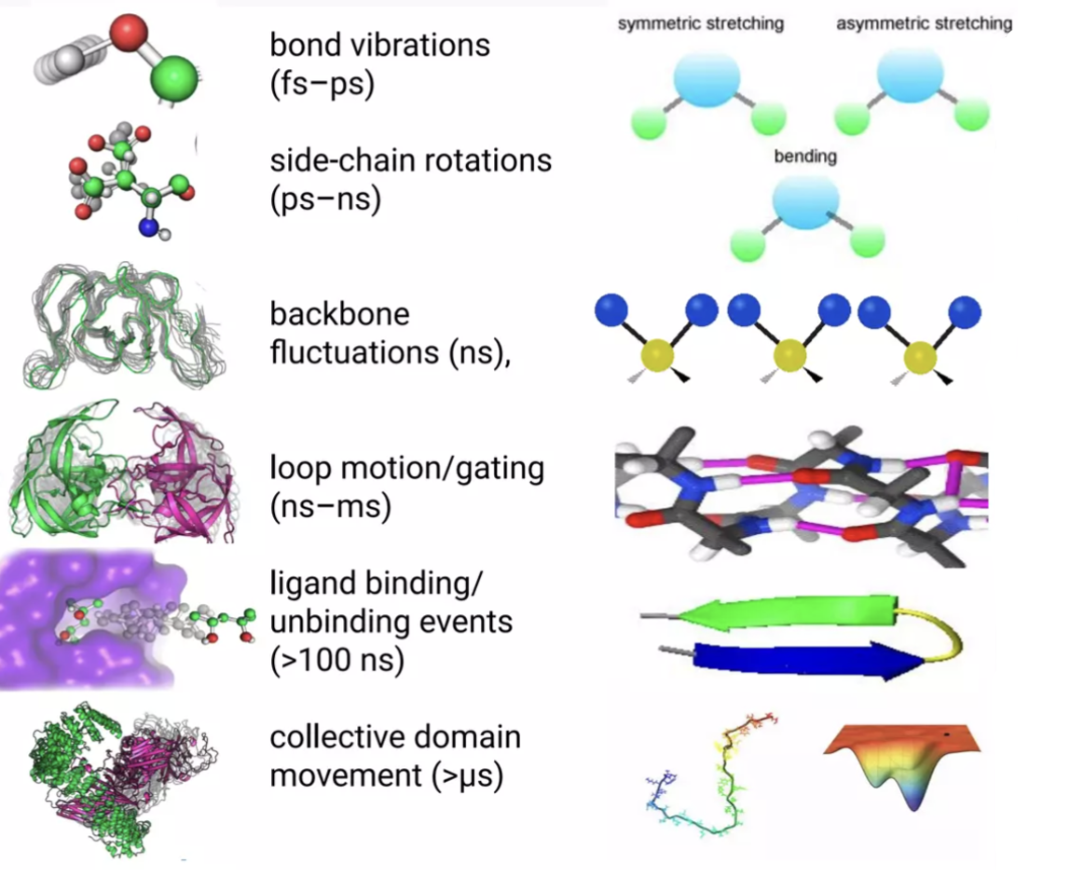
Hierarchy of principal motions during MD

